Slide 1

Daniel Fox (QA Manager) Thyagaraj Raghava (QA/Data Analyst) Manisha Shah (Business Analyst) Prashant Baral (Software Tester)
Arun Garwan (Software Tester)
Deepali Sawant (Software Tester)
Team 1

Slide 2
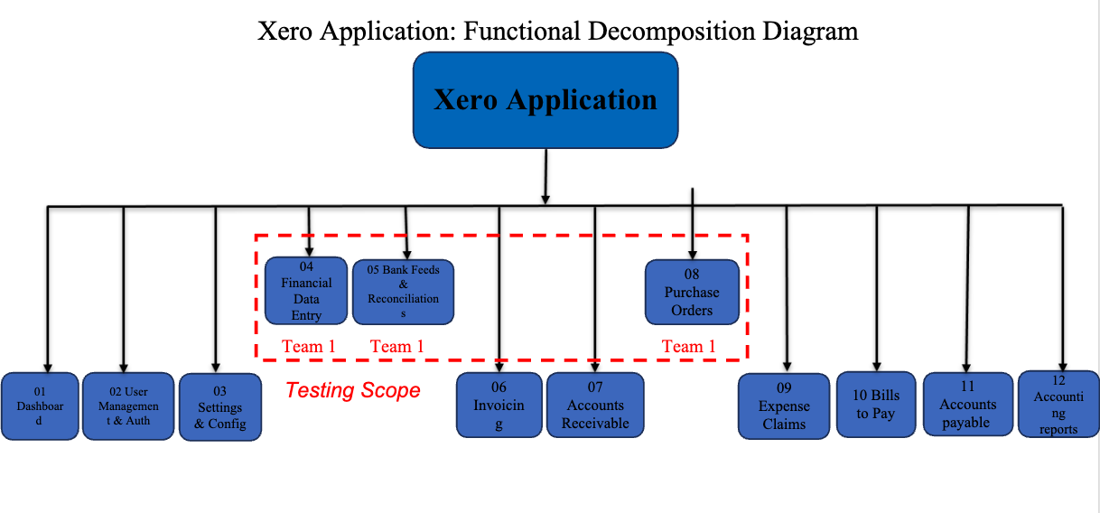
Functional Decomposition Diagram
(presented by Daniel Fox)

Slide 3
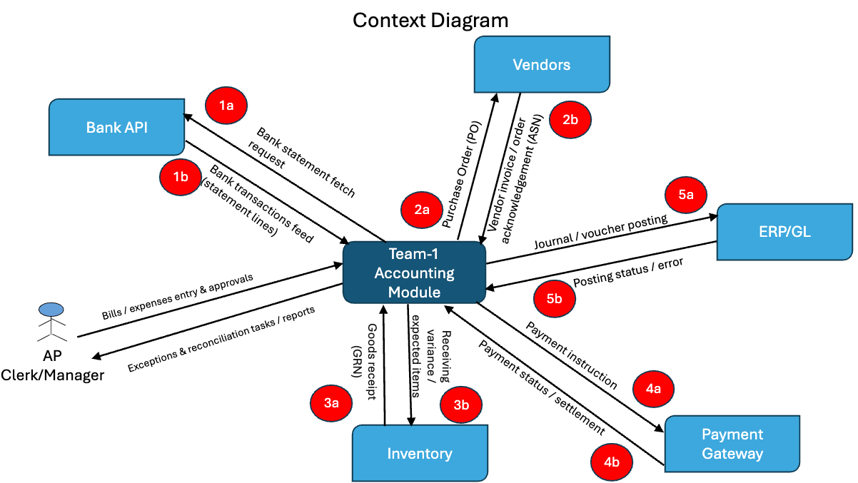
Context Diagram
(presented by Prashant Baral)

Slide 4
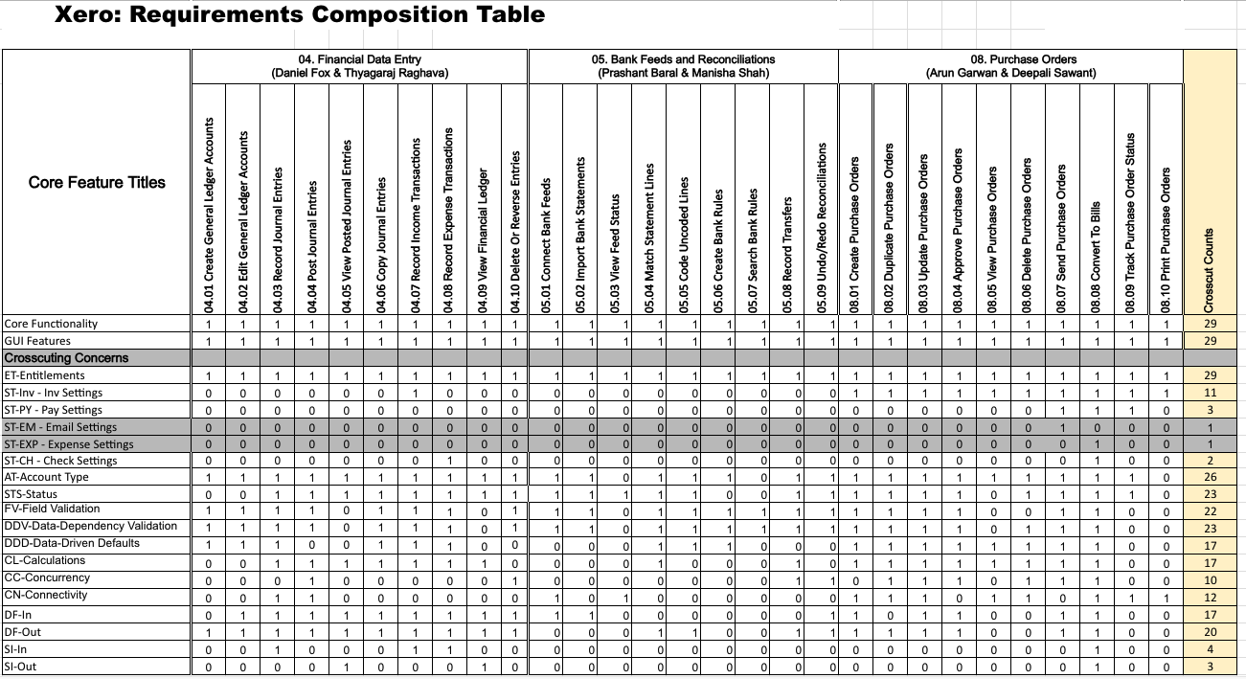
RCT (presented by Prashant Baral)

Slide 5
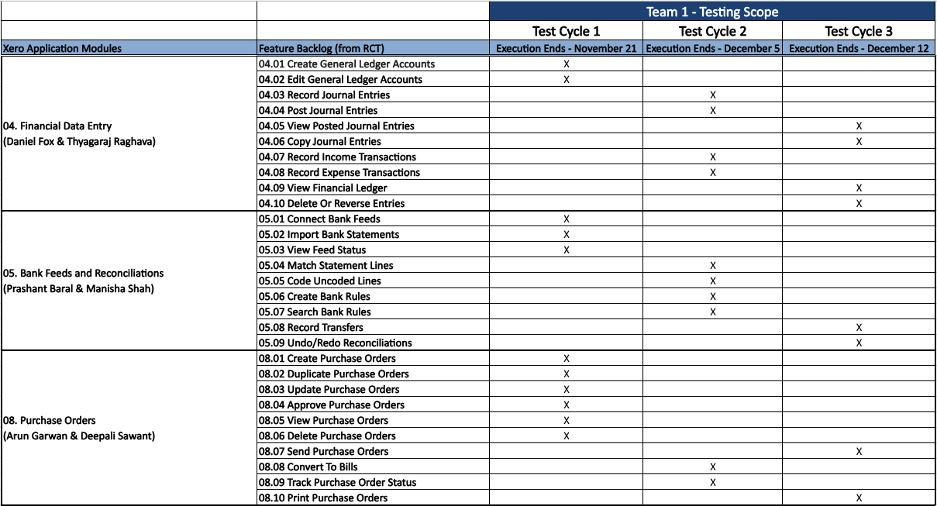
Testing RoadMap
(presented by Arun Garwan)

Slide 6
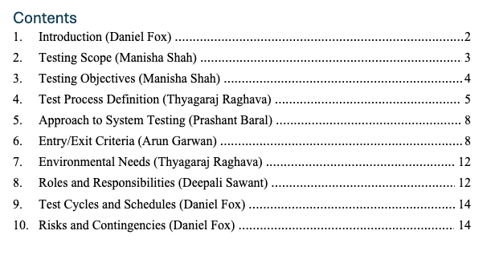
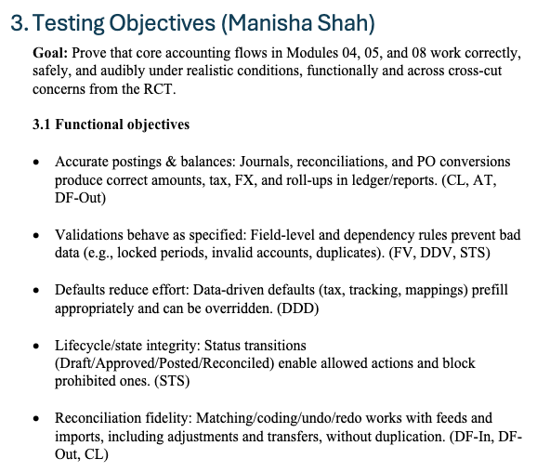
Test Plan
(presented by Manisha Shah)

Slide 7
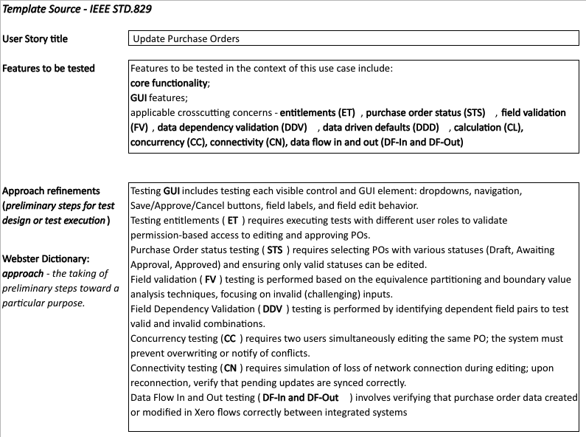
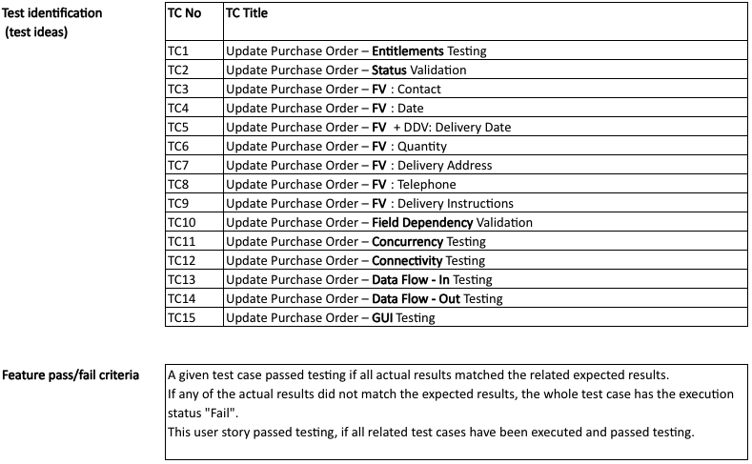
Test Design Specification
(presented by Deepali Sawant)

Slide 8
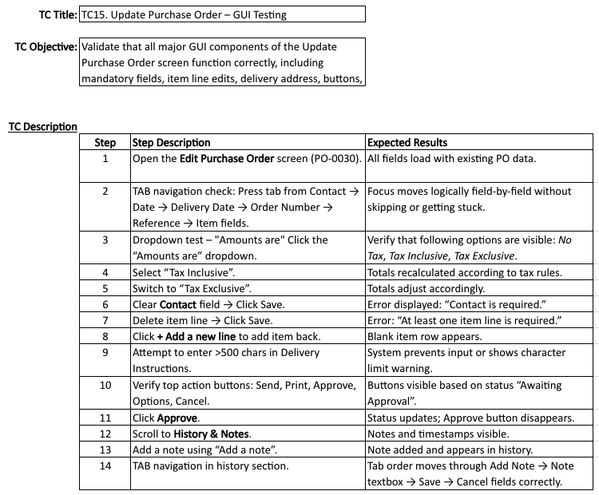
Test Case Specification
(presented by Deepali Sawant)

Slide 9
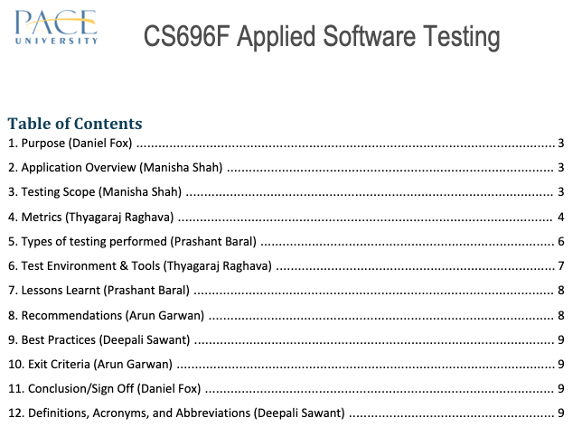
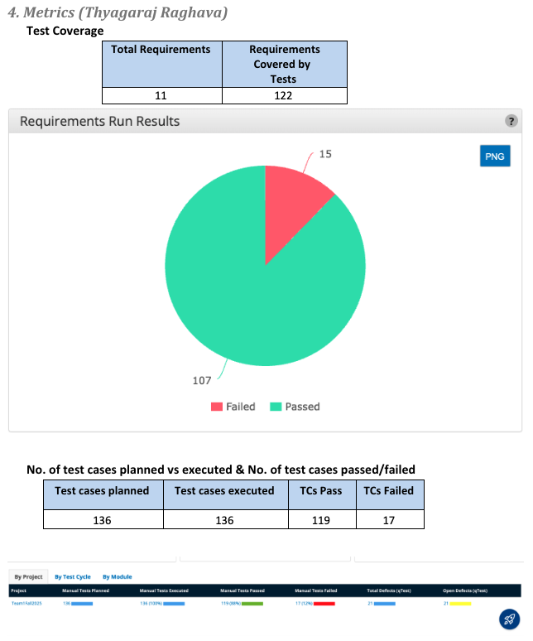
Test Summary Report
(presented by Thyagaraj Raghava)

Slide 10
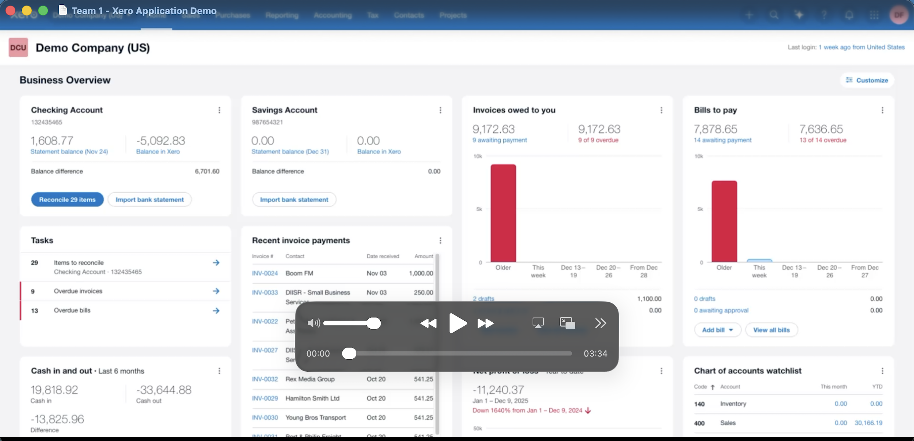
Application Recorded Demo
(presented by Daniel Fox)

Slide 11
Appendix:
GitHub Repository

Slide 12

GitHub Repo Link
🔗 https://github.com/dfox131/CS696F-Team1

Slide 13


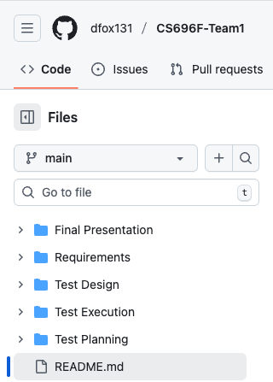

GitHub Repo Folder Structure
Requirements
Test Planning
Test Design
Test Execution
Final Presentation
README.md

Slide 14
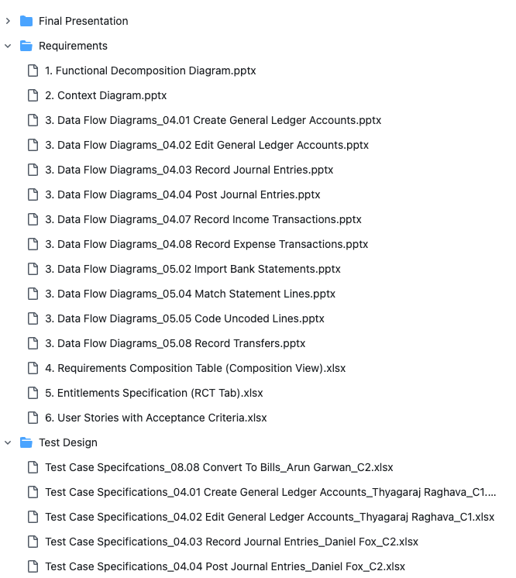
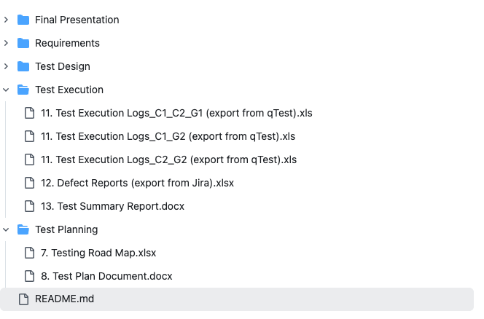
GitHub Repo Folder Structure

Slide 15
Thank You

